Slide 1
Introduction to Advanced Machine Learning
Lesson 21.1

Slide 2
Class Objectives
By the end of this lesson, you will be able to:
Describe the differences between traditional machine learning classification and regression models and neural network models.
Describe the perceptron model and its components.
Implement neural network models using TensorFlow.

Slide 3
Surfing the Neural Net
Notes:
1.1 Instructor Do: Surfing the Neural Net (5 min)

Slide 4
What is a Neural Network?

Slide 5
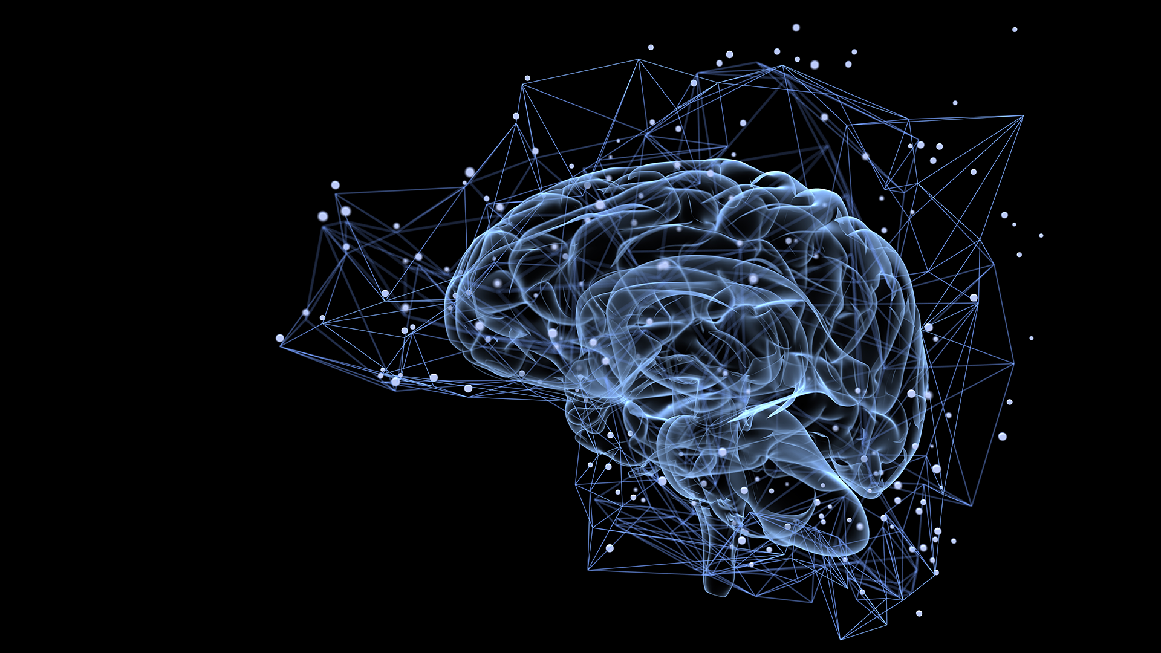
What Is a Neural Network?
Neural networks are a powerful machine learning technique modeled after neurons in the brain.
Industry leaders such as Google, Facebook, Twitter, and Amazon use neural networks for analyzing complex datasets.

Slide 6
Neural Network is an advanced form of machine learning that contains multiple layers of nodes, which perform individual computations.

Slide 7
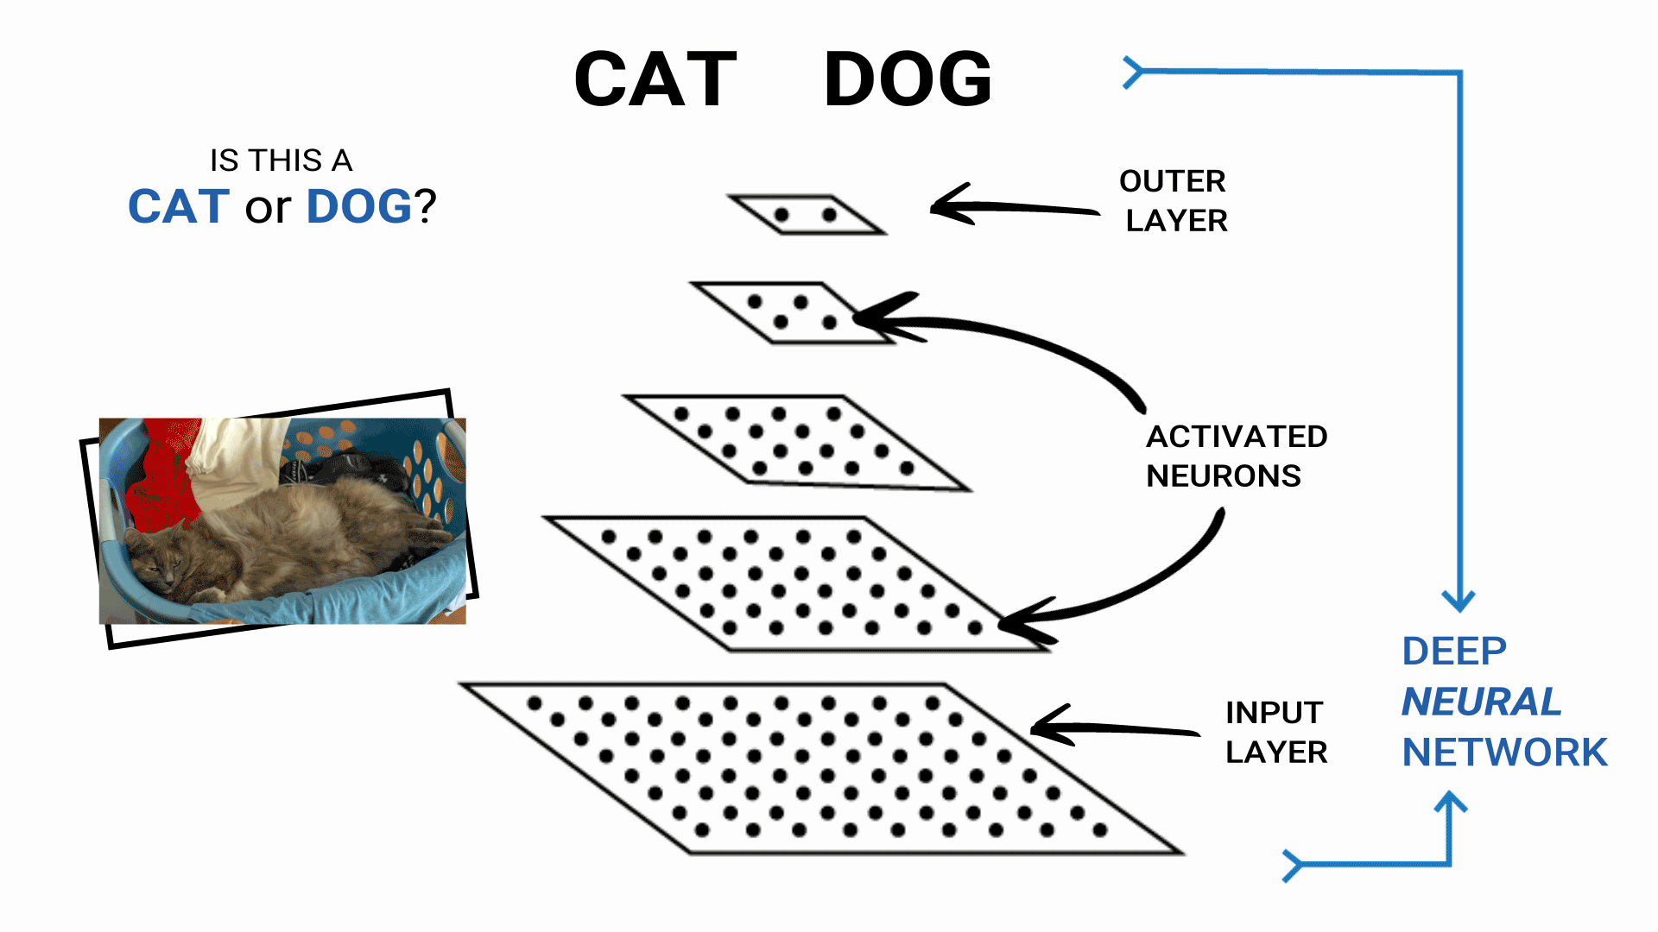
What Is a Neural Network?
In its simplest form, a neural network contains layers of neurons that perform individual computations.

Slide 8
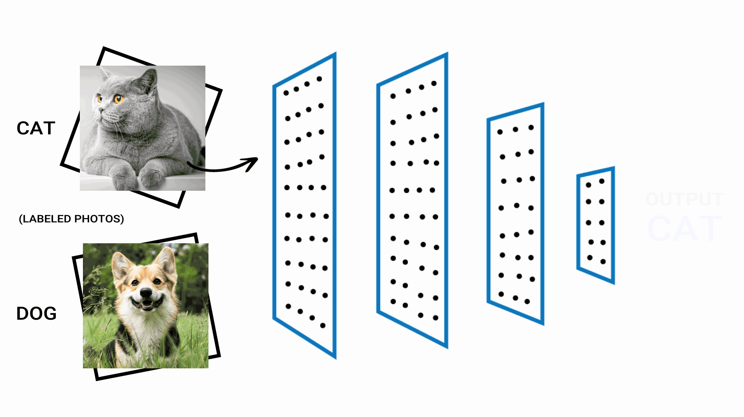
What Is a Neural Network?
These computations are connected and weighed against one another until the neurons reach the final layer. In the final layer, the neurons return either a numerical result or an encoded categorical result.

Slide 9
What Is a Neural Network?
Training
Neural networks are an advanced form of machine learning that:
Recognizes patterns and features of input data
Provides a clear quantitative output
Input
Recognition
Result

Slide 10
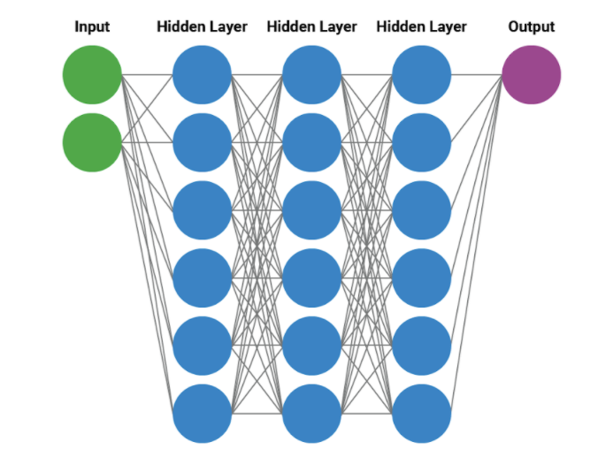
Neural Net
Example diagram of a neural network:
A neural network can train on each pixel of each image as a scaled value from 0 (completely white) to 1 (completely black). With enough data points, a trained neural network model can classify handwritten numbers with a high degree of accuracy.

Slide 11
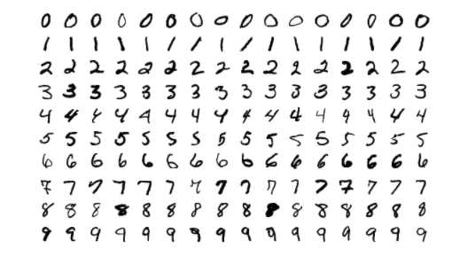
The MNIST Dataset
The MNIST (Modified National Institute of Standards and Technology) dataset contains black and white images of handwritten numbers.
A neural network can train on each pixel of each image as a scaled value from zero (completely white) to one (completely black). With enough data points, a trained neural network model can classify handwritten numbers with a high degree of accuracy.
Sample images from MNIST test dataset

Slide 12
Neural Net
The following diagram plots the different types of machine learning models:
High
Linear/Logistic
Regression
Decision Trees
Interpretability
Naive Bayes
Random Forest
Boosting
Nearest
Neighbors
SVMs
Neural Nets
Low
Deep Learning
Accuracy
High

Slide 13

Neural Net
Neural networks are very useful in data science because they serve multiple purposes. Two popular uses include:
Classification algorithms that determine how to categorize an input.
Regression models that predict a dependent output from independent input variables.

Slide 14
Activity: Working Through the Logistics
In this activity, you'll use a logistic regression to categorize data from the make_blobs function from scikit-learn to create data.
15 minutes
Notes:
1.3 Students Do: Working Through the Logistics (15 min)

Slide 15
Activity: Working Through the Logistics
Instructions | Use the starter code provided to create your make_blobs dataset from scikit-learn.
 | Split your dataset into training and testing sets using scikit-learn's train_test_split module.
 | Create a LogisticRegression instance from scikit-learn's LogisticRegression model.
Hint | If you need a reminder on how to create a LogisticRegression model, review the Scikit-learn documentation.
 | Train your LogisticRegression model on the training dataset.
 | Evaluate your trained LogisticRegression model using the accuracy_score metric from scikit-learn.

Slide 16
Notes:
1.4 Review: Picking Our Brains on Neural Networks (10 min)

Slide 17
Perceptron, the Computational Neuron
Notes:
2.1 Instructor Do: Perceptron, the Computational Neuron (10 min)

Slide 18
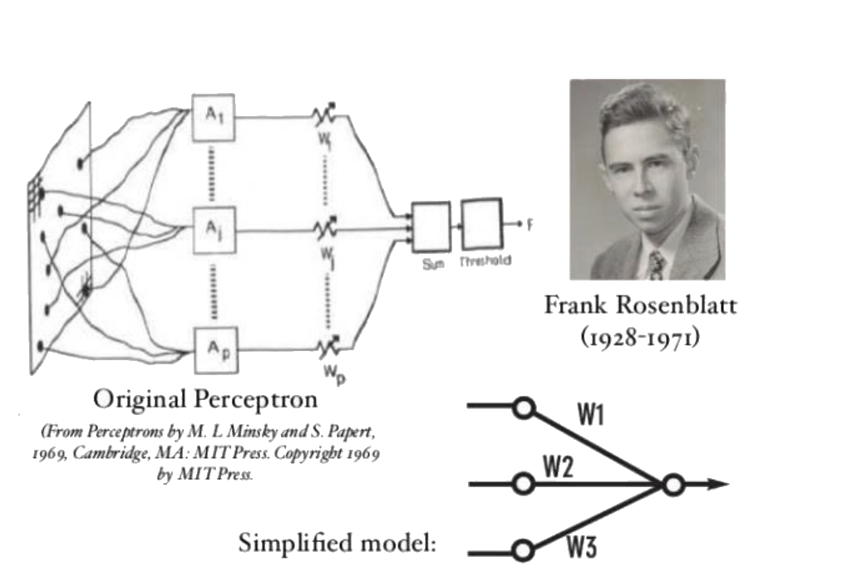
Perceptron
Artificial neural networks have become popular in recent years. But, the original design for a computational neuron, known as a perceptron, dates back to the late 1950s.
Perceptron was introduced by Frank Rosenblatt in 1957. He proposed a Perceptron learning rule based on the original MCP neuron.

Slide 19
A Perceptron is an algorithm for supervised learning of binary classifiers. This algorithm enables neurons to learn and processes elements in the training set one at a time.

Slide 20
Meet the Perceptron
The perceptron model mimics a biological neuron by receiving input data, weighting the information, and producing a clear output.
w₁
bias
w₀
x₀
w₁
Activation Function
x₁
w₂
Σ
Input values
x₂
w_{i} x x_{i}
Output
y
Summation
. . .
w...
w_{n}
x_{n}

Slide 21
The perceptron model has
four major components.

Slide 22
Input Values (shown as x's)
w₁
bias
w₀
x₀
x₁
w₁
Activation Function
Σ
Input values
x₂
w₂
w_{i} x x_{i}
Output
y
Summation
. . .
w...
The input values, which are typically labelled as 𝜒 or chi. Depending on how many features or variables exist in the dataset, the number of input values will change.
w_{n}
x_{n}

Slide 23
Weight Coefficients (denoted as w's)
w₁
bias
w₀
x₀
x₁
w₁
Activation Function
Σ
Input values
x₂
w₂
w_{i} x x_{i}
Output
y
Summation
. . .
w...
The weight coefficients are applied to each input value to help the machine learning model identify features of interest. The weight coefficients are typically labelled as w or omega.
w_{n}
x_{n}

Slide 24
A Constant Value Called Bias
w₁
bias
w₀
Bias adjusts the model to make it either more or less sensitive to the weights.
x₀
x₁
w₁
Activation Function
Σ
Input values
x₂
w₂
w_{i} x x_{i}
Output
y
Summation
. . .
w...
The bias term is an additional input typically labelled as ⍵. The bias term helps to shift the output of the model, which may be necessary for properly training the model.
w_{n}
x_{n}

Slide 25
Net Summary Function (the Summation)
w₁
bias
w₀
x₀
x₁
w₁
Activation Function
Σ
Input values
x₂
w₂
w_{i} x x_{i}
Output
y
Summation
. . .
w...
w_{n}
Summation aggregates all weighted inputs to feed into the activation function.
x_{n}

Slide 26
A perceptron model—also known as a linear binary classifier—contains a linear equation that separates data into two groups. This is the most common use.

Slide 27
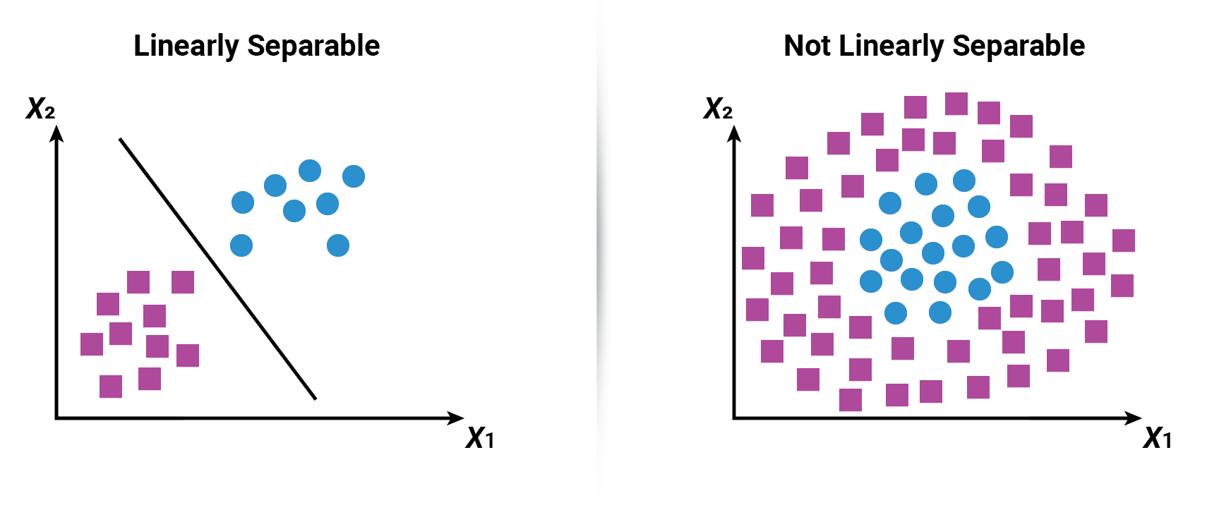
Linearly Separable
Consider linearly separable, the perceptron algorithm separate and classify the data into two groups using linear equation.

Slide 28
Since we provide the model our input feature and parameters the perceptron model is a form of supervised machine learning.

Slide 29
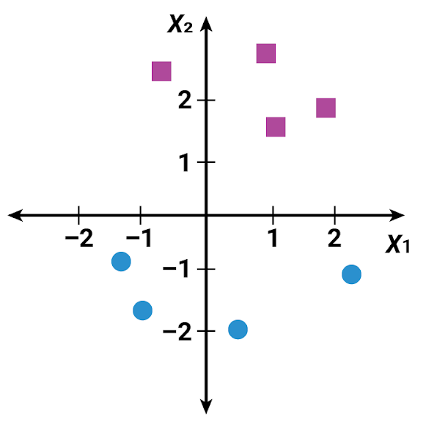
Perceptron Example
Our model will try to classify values in a two-dimensional space; our perceptron model will use three inputs:
𝜒1 | the x value
𝜒2 | the y value
⍵0 | the bias constant
The end result of our two-dimensional perceptron model is the net sum function: ⍵0 + 𝜒1⍵1 + 𝜒2⍵2.

Slide 30
If a data point is misclassified, the weights will move the model closer to the missed data point.

Slide 31
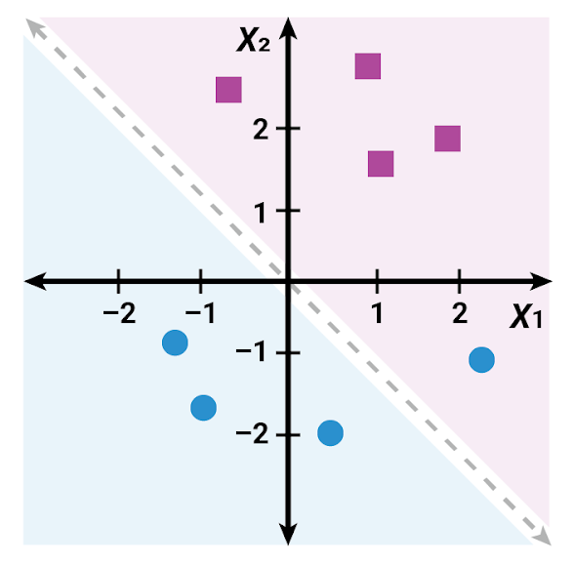
Untrained Perceptron Model on Our Dataset
An untrained model almost classified the two groups perfectly.
It misclassified one blue circle.

Slide 32
Untrained Perceptron Model on our Dataset
The perceptron model will evaluate each data point and determine if the input weights should change.
If a data point is classified correctly, the weights will not change.
If a data point is misclassified, the weights will move the model closer to the missed data point.

Slide 33
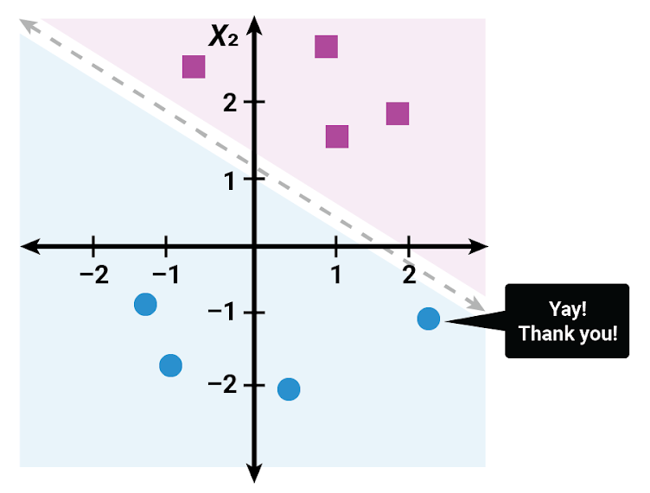
Trained Perceptron Model on our Dataset
Each data point is evaluated to determine if the input weights should change.
Since a data point is misclassified, the weights will move the model closer to the missed data point.

Slide 34
The Neural Network
Input
Hidden layer
Output
A modern neural network model is a structure composed of several connected perceptrons that learn from input data to produce an output.

Slide 35
The Structure of a Neural Network
An input layer of input values transformed by weight coefficients
Input
Hidden layer
Output

Slide 36
The Structure of a Neural Network
A single hidden layer that can contain a single neuron or multiple neurons
Input
Hidden layer
Output

Slide 37
The Structure of a Neural Network
An output layer that reports the outcome of the value
Input
Hidden layer
Output

Slide 38
If each neuron has its own output, how does the neural network combine each neuron's output into the model's classification or regression output?

Slide 39
Activation Functions

Slide 40
Activation Functions
Neural networks link neurons that process input together to produce a clear, quantitative output.
An activation function combines all these outputs into a single classifier or regression model.
When building a model, we apply the activation function to the end of each neuron (each individual perceptron model).
This mathematical function transforms each neuron’s output into a quantitative value.
The quantitative output value becomes the input value for the next layer in the neural network model.

Slide 41
Activation Function (Transformation After Summation)
w₁
bias
w₀
x₀=1
x₁
w₁
Activation Function
Σ
Input values
x₂
w₂
w_{i} x x_{i}
Output
y
Summation
. . .
w...
w_{n}
x_{n}

Slide 42
A wide variety of activation functions exist, and each has a specific purpose.
However, most neural networks will use one of the following activation functions.

Slide 43
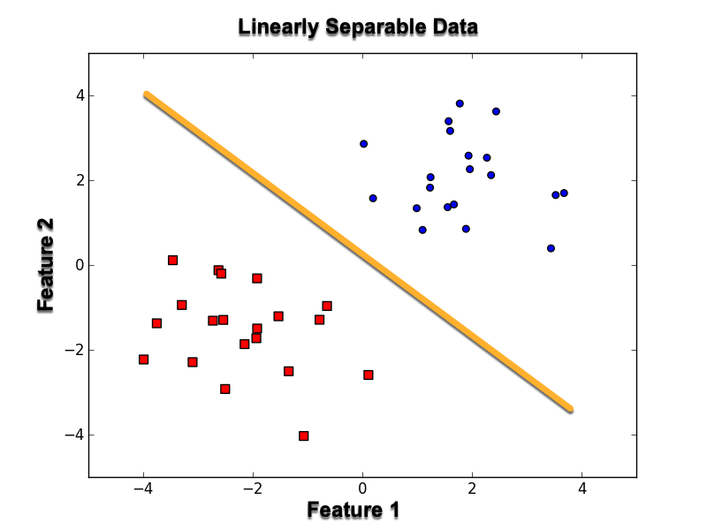
Linear Function
The linear function transforms the output into the coefficients of a linear model (the equation of a line).
Linearly separable data
Feature 2
Feature 1

Slide 44
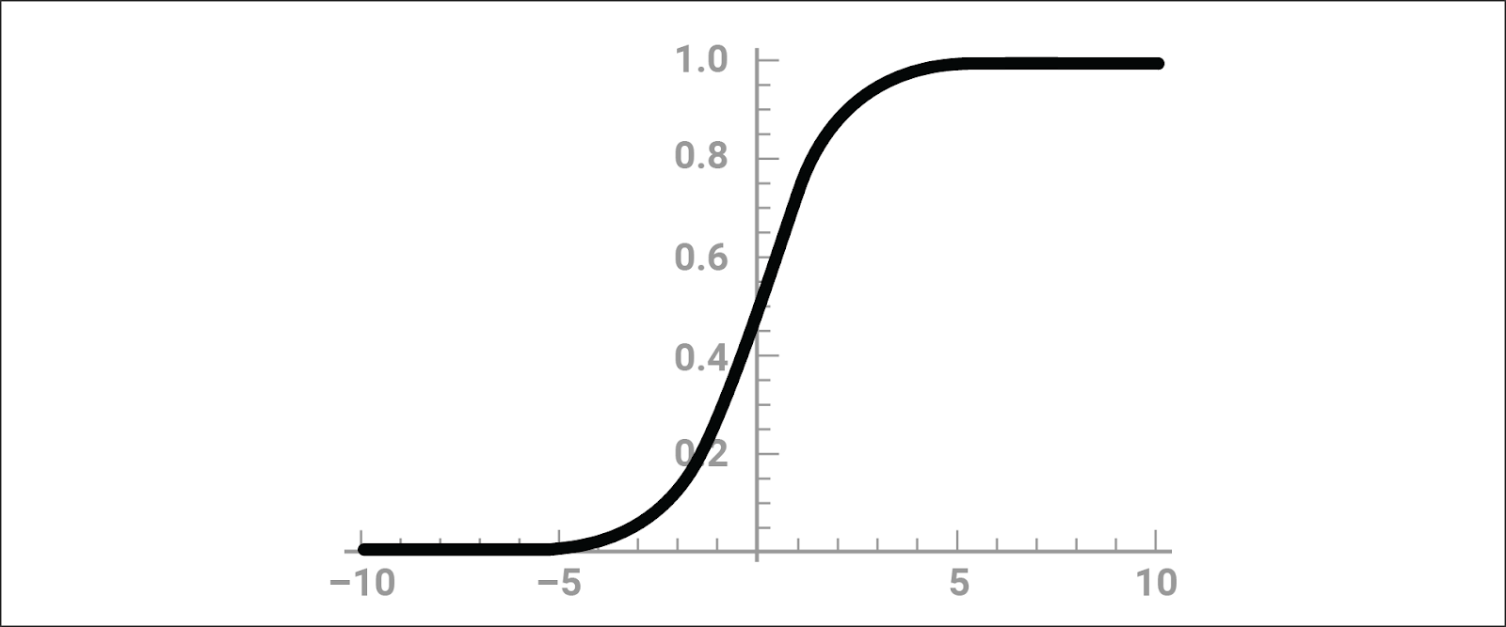
Sigmoid Function
The sigmoid function transforms the neuron’s output to a range between 0 and 1, which is especially useful for predicting probabilities. A neural network that uses the sigmoid function will output a model with a characteristic S-curve.

Slide 45
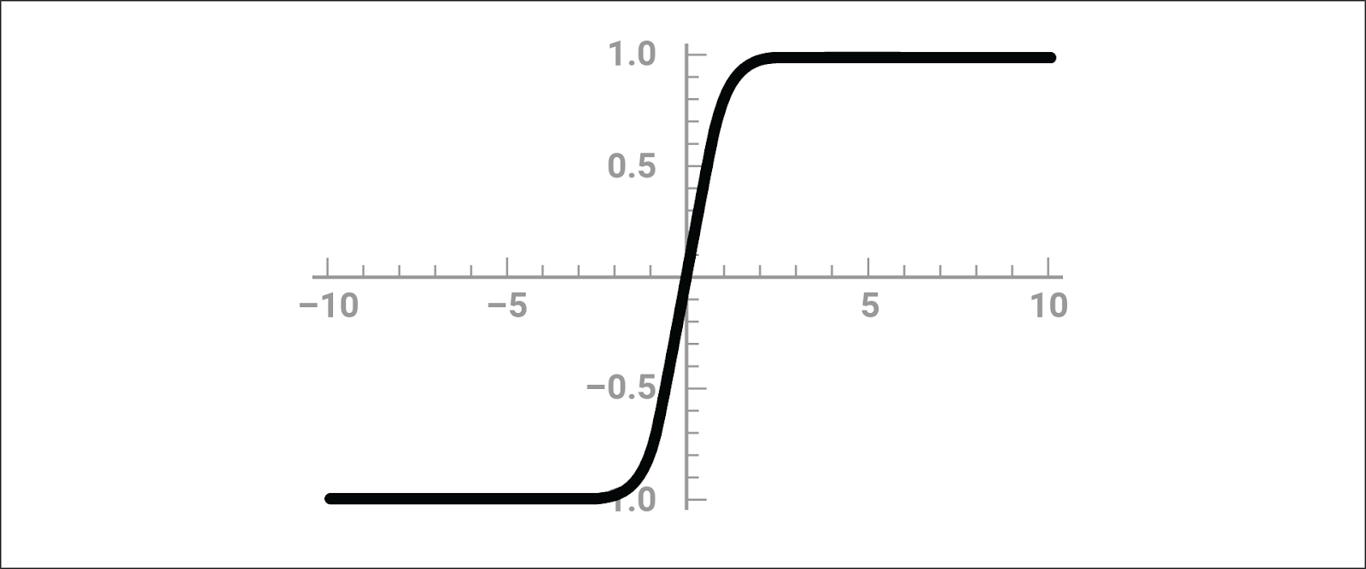
Tanh Function
The tanh function transforms the output to a range between –1 and 1.
The output for a model using a tanh function also forms a characteristic S-curve. It’s primary use is classifying data into one of two classes.

Slide 46
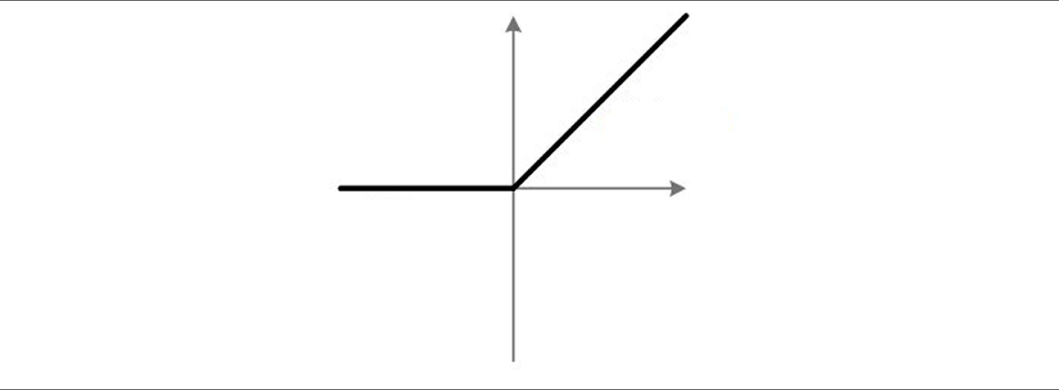
Rectified Linear Unit (ReLU)
The rectified linear unit (ReLU) function returns a value from 0 to infinity. This activation function transforms any negative input to 0. It is the most commonly used activation function in neural networks due to its faster learning and simplified output. However, it is not always appropriate for simpler models.

Slide 47
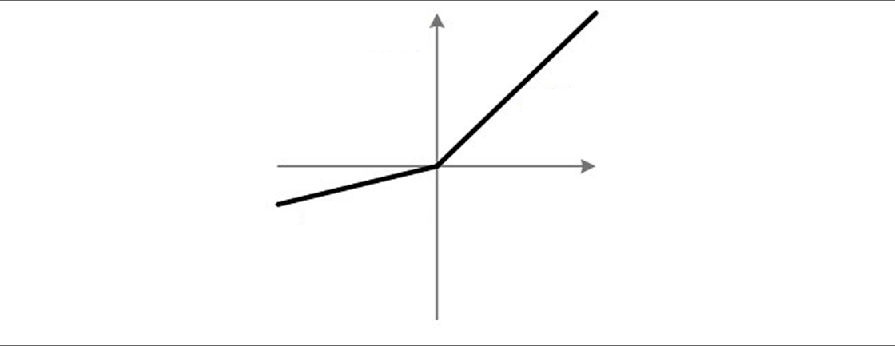
Leaky ReLU Function
The leaky ReLU function is an alternative to the ReLU function, which can sometimes work better. Instead of transforming negative input values to 0, it transforms them into much smaller negative values.

Slide 49

TensorFlow Playground
Notes:
2.3 Everyone Do: Playing in TensorFlow Playground (15 min)

Slide 50
TensorFlow is a neural network and machine learning library for Python that has become an industry standard for developing robust neural network models.

Slide 51

Creating a Neural Network
Why TensorFlow?
Machine learning library
Used to build neural networks
Runs on multiple platforms
Supports distributed computing
Allows detailed fine-tuning

Slide 52
Modeling Workflow
Regardless of what machine learning model or technology we use, we follow the same general modeling workflow across all of data science:
01
Decide on a model and create a model instance.
02
Split the dataset into training and testing sets and preprocess the data.
03
Train/fit the training data to the model.
04
Evaluate the model for predictions and transformations.

Slide 53
TensorFlow Playground
15 minutes
Notes:
TensorFlow Playground.

Slide 55
Setup Google Colab
Notes:
2.4 Instructor Do: Setup Google Colab (15 min)

Slide 57
Understanding the TensorFlow Neural Network Structure
Notes:
2.5 Instructor Do: Understanding the TensorFlow Neural Network Structure (15 min)

Slide 58
Notes:
Break

Slide 59
Work Through a Neural Network Workflow
20 minutes
Notes:
3.1 Everyone Do: Work Through a Neural Network Workflow (20 minute)

Slide 60
Activity: BYONNM—Build Your Own Neural Network Model
In this activity, you'll use a neural network model to classify the data from make_blobs.
20 minutes
Notes:
3.2 Student Do: BYONNM—Build Your Own Neural Network Model (20 min)

Slide 61
Activity: Working Through the Logistics
Instructions | Using the starter code provided, visualize the blobs dummy dataset using a Pandas scatter plot.
 | Randomly split the dummy data into training and test datasets using scikit-learn's train_test_split method.
 | Normalize both datasets using scikit-learn's StandardScaler class.
 | Using the Keras module, create a basic neural network with five neurons in the hidden layer. Note: Your neural network should use two inputs and produce one classification output.
 | Compile your basic neural network model.
 | Train the neural network model over 50 epochs.
 | Evaluate the performance of your model by printing your test loss metric and determining the predictive accuracy of the model on the test dataset.
Bonus | Create a new neural network with a different number of neurons.
 | Train the new neural network model on the same training data and test the performance on the same testing dataset.
 | Create a line plot that visualizes the neural network predictive accuracy over each epoch.

Slide 62
Notes:
3.3 Review: BYONNM—Build Your Own Neural Network Model (10 min)

Slide 63
Notes:
3.4 Instructor Do: Debrief and End Class (5 min)

